Slide 1



Department of Electronics Engineering
Walchand College of Engineering, Sangli
(Government-Aided Autonomous Institute)
Group No: 13
Project A.Y. 2025-2026
Smart Interactive Vision with Object Tracking and Voice Command
Under the guidance of
Prof. Sachin Ruikar

Slide 2



TEAM MEMBERS (GROUP - 13)
Gayatri Dabhade
PRN - 22410052
Achala Paradeshi
PRN - 22410053
Akshat Gupta
PRN - 22410063

Slide 3
OVERVIEW
Introduction
Literature Survey
Project Idea
Components
Block Diagram
Working
Objectives
Application
Future Scope

Slide 4


INTRODUCTION
This project presents a real-time intelligent vision system capable of face detection, tracking, and voice-based interaction using computer vision and embedded systems. The system uses OpenCV and MediaPipe for accurate face detection through a USB camera and calculates face coordinates in real time. A proportional controller with EMA smoothing is applied to achieve stable and smooth servo movement. The processed commands are sent through USB serial communication to an Arduino Uno, which controls SG90 servo motors for camera pan and tilt motion. Compared to the earlier Raspberry Pi and Wi-Fi-based design, the current architecture uses direct USB communication, reducing latency and simplifying deployment. The project demonstrates an efficient, low-cost, and responsive face-tracking platform using a standard laptop and Arduino microcontroller.

Slide 5
LITERATURE SURVEY
Viola-Jones Face Detection (2001)
Introduced Haar Cascade face detection
Enabled real-time face tracking
Limited performance in poor lighting and side poses
YOLO Object Detection (2016)
Real-time deep learning object detection
High speed and accuracy
Inspired lightweight detection systems like MediaPipe
Servo-Controlled Tracking (2020)
Combined computer vision with servo motors
Used microcontroller-based face tracking
Introduced error-based servo angle correction using P-controller

Slide 6
LITERATURE SURVEY
MediaPipe Framework (2019)
Lightweight and fast face detection framework
Works efficiently on CPU without GPU
Used in this project for low-latency face tracking
ArcFace / InsightFace (2019)
Advanced face recognition using deep learning
Generates accurate facial embeddings
Supports real-time identity recognition
DeepFace Emotion Analysis
Detects facial emotions using CNN models
Identifies emotions like happy, sad, angry, neutral
Useful for smart interactive systems

Slide 7
PROBLEM STATEMENT
Limitations of Traditional Systems
Inconsistent Tracking
Mechanical play and open-loop control cause imprecise face centering.
High Latency
HTTP/Wi-Fi based protocols introduce 100–200 ms delays.
Poor Lighting Robustness
Traditional detectors fail under dynamic lighting or fast motion.
Complex Hardware Setup
Raspberry Pi requires full Linux OS, SSH configuration, and GPIO library management.
High Component Cost
Using an SBC solely for servo PWM generation increases system cost (₹4,000–5,000).

Slide 8
PROPOSED SOLUTION
This project proposes an intelligent, vision-guided tracking system implemented on a laptop that offloads servo actuation to an Arduino Uno microcontroller via USB serial. The key design decision is the separation of concerns:
• The laptop runs all computationally intensive tasks: face detection (MediaPipe), face recognition (ArcFace), emotion analysis (DeepFace), Pcontroller logic, and the Flask web server.
• The Arduino Uno handles only servo PWM generation—a task perfectly matched to a low-cost 8-bit microcontroller—receiving pre-computed pan and tilt angles over a reliable wired serial link.

Slide 9
OBJECTIVES
1.
Develop a real-time face detection & recognition system using OpenCV, MediaPipe, and InsightFace via a USB webcam.
2.
Implement a closed-loop P-controller with EMA smoothing for jitter-free servo tracking.
3.
Integrate Arduino Uno as a dedicated servo controller over USB serial (pyserial at 115,200 baud).
4.
Design a two-axis pan–tilt mechanism using two SG90 servos (Pan 40°–140°, Tilt 55°–125°).
5.
Build a Flask web application with MJPEG streaming, SQLite attendance DB, and REST API.

Slide 10
OBJECTIVES
5.
Build a Flask web application with MJPEG streaming, SQLite attendance DB, and REST API.
6.
Integrate Google TTS + pygame for non-blocking voice feedback on recognition events.
7.
Ensure reliability under variable lighting, multiple simultaneous faces, and rapid head movements.
8.
Create a modular, scalable architecture extensible for surveillance, attendance & assistive tech.

Slide 11

HARDWARE COMPONENTS
USB Webcam
Arduino Uno R3
SG90 Servo (×2)
640×480 @ 30 fps
USB 2.0 plug-and-play
Mounted on tilt servo bracket
ATmega328P 16 MHz
32 KB Flash, Hardware PWM
UART 115,200 bps
180° micro servo
1.8 kg·cm @ 4.8 V
50 Hz PWM, 500–2400 μs
Microphone
Speaker
External 5 V PSU
USB / 3.5 mm input
speech_recognition library
Commands: start, stop, identify
Compact active speaker
gTTS + pygame.mixer
Priority-queued TTS playback
4×AA or USB power bank
≈1.2 A capacity
Powers both servos independently

Slide 12
SOFTWARE STACK
Vision
Control
•OpenCV — frame capture & processing
•MediaPipe BlazeFace — face bounding box detection
•InsightFace (ArcFace) — 512-d face embeddings
•DeepFace — emotion classification (happy/sad/angry…)
•arduino_serial.py — ArduinoBridge class (pyserial)
•servo_ctrl.py — P-controller + EMA smoothing
•25 px deadzone to suppress servo chatter
•Servo.h on Arduino — hardware PWM at 50 Hz
Web & DB
Voice
•Flask (app.py) — web server & REST API
•MJPEG /video_feed streaming endpoint
•SQLAlchemy + SQLite — Person & Attendance ORM
•JavaScript (fetch) — live dashboard updates
640×480 @ 30 fps
•gTTS — text-to-speech MP3 synthesis
•pygame.mixer — non-blocking audio playback
•speech_recognition — Google STT voice cmds
•Priority queue — urgent alerts interrupt TTS
Mounted on tilt servo bracket

Slide 13
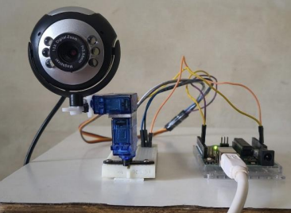




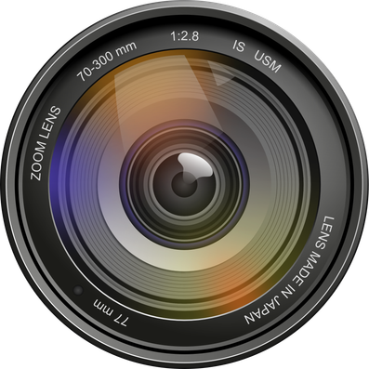

HARDWARE ASSEMBLY

Slide 14
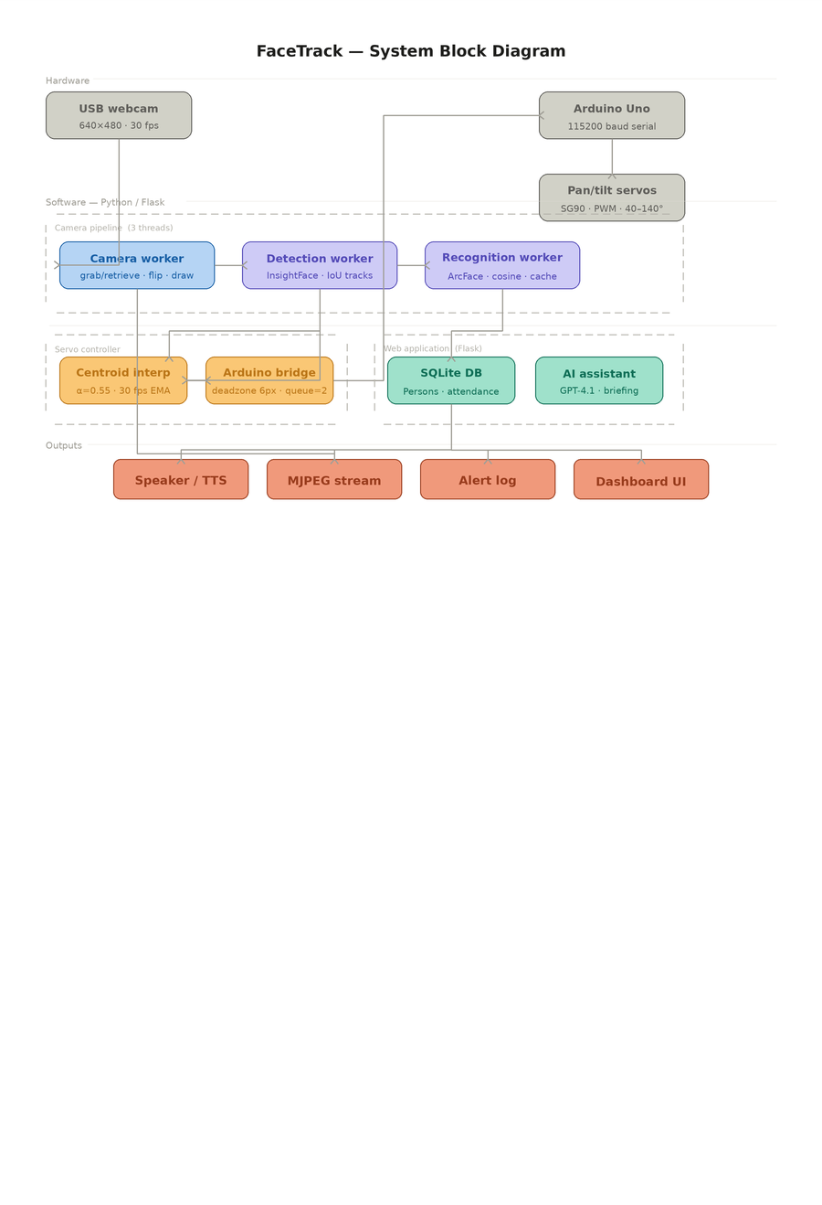
BLOCK DIAGRAM

Slide 15
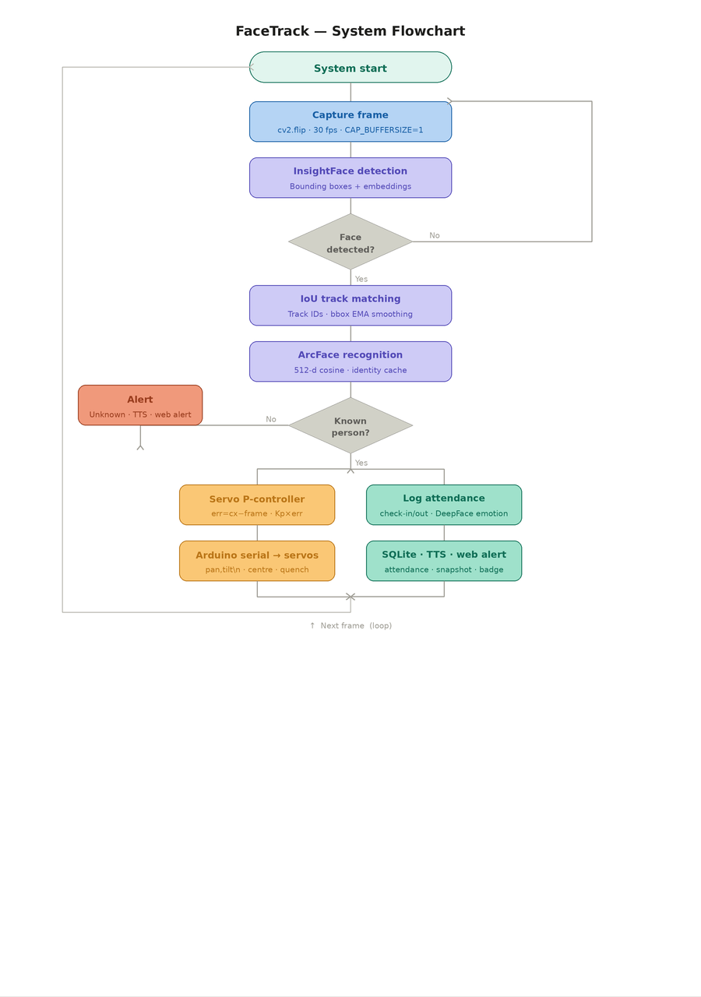
FLOW CHART

Slide 16
WORKING
FaceTrack operates as a continuous closed-loop pipeline running at 30 fps across three parallel threads:
Thread 1 captures frames from the USB webcam, flips them, draws annotations, and streams MJPEG to the browser dashboard.
Thread 2 runs InsightFace detection at ~12 fps, assigns stable track IDs using IoU matching, and updates the servo target centroid.
Thread 3 compares ArcFace 512-d embeddings against the SQLite database via cosine similarity, logs attendance, and classifies emotion using DeepFace.
The P-controller computes error = face_cx − 320, applies EMA smoothing, and sends new_angle += Kp × error as a "pan, tilt" serial command to the Arduino Uno at 115,200 baud. The Arduino calls Servo.write() on PWM pins 9 and 10, physically recentring the camera. As the face reaches the frame centre, error → 0 and the servo holds still — completing the feedback loop.
Unknown faces trigger an instant TTS alert and web badge. Recognised persons are auto-logged to SQLite with timestamp, emotion, and confidence score.

Slide 17
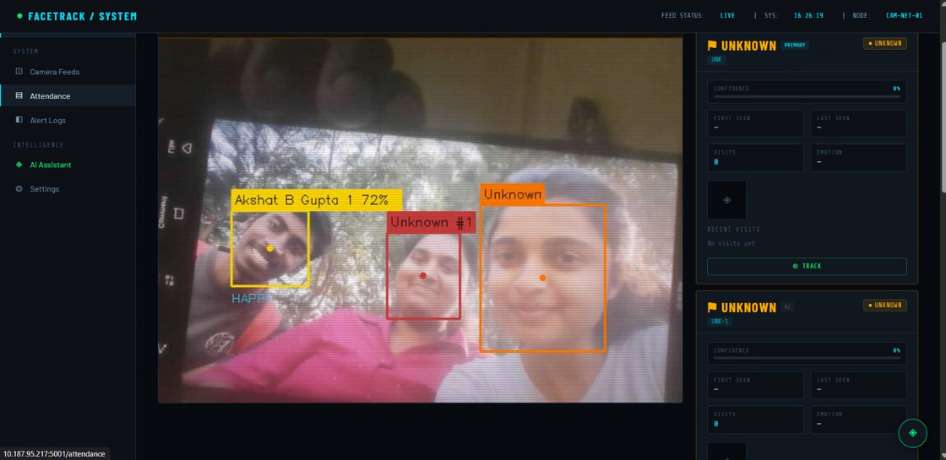
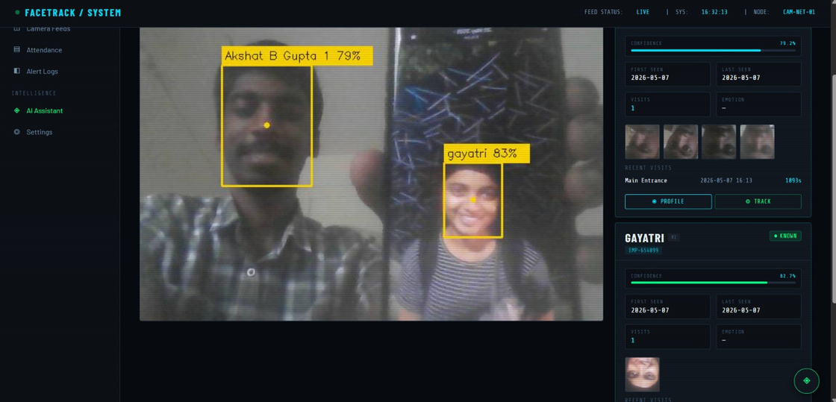
RESULTS
Group with Unknown Alert
Akshat (72%, yellow) identified among two unregistered subjects — Unknown #1 (red) and Unknown (orange, primary). UNKNOWN cards show 0 visits and no timestamps, confirming zero false-positive assignments. Dashboard accessed remotely from 10.187.95.217:5001.
Dual Known Subjects (Best Accuracy)
Peak recognition performance: Akshat 79%, Gayatri 83% — both under frontal lighting. Session duration 1093 s (≈18 min) logged without identity dropout. Servo tracking dot visible at face centre confirming active P-controller operation.

Slide 18
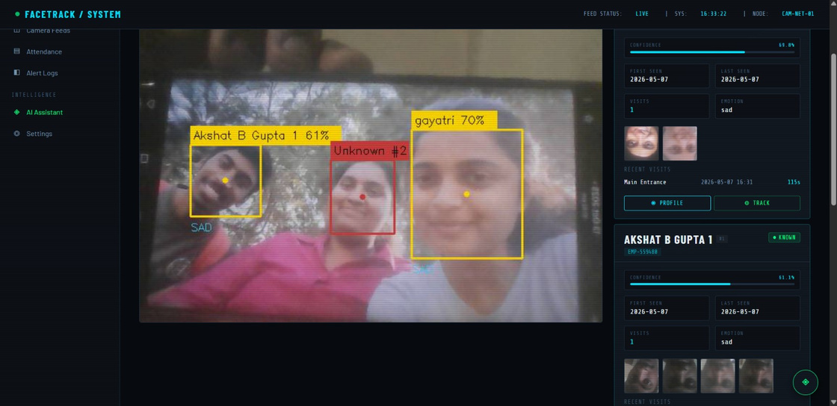
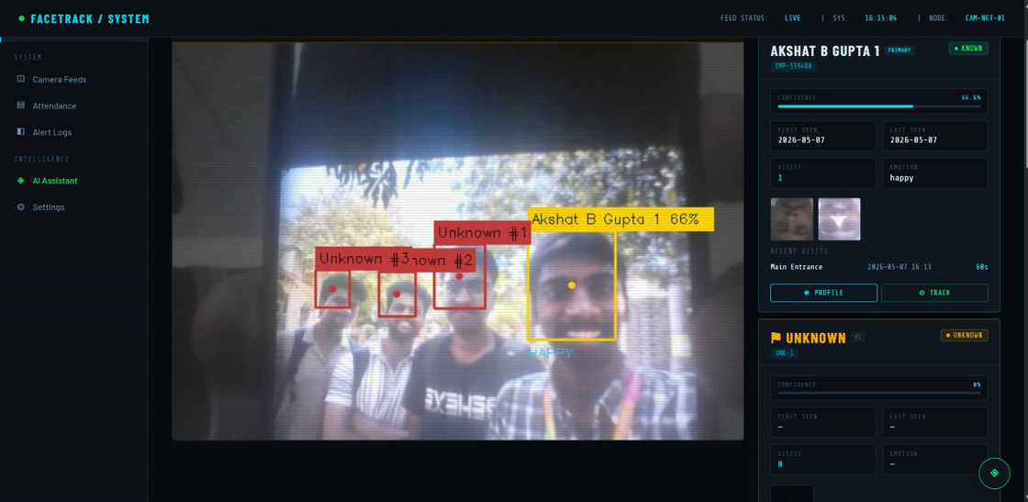
RESULTS
Mixed Recognition (3 faces)
Three simultaneous detections: Akshat B Gupta (61%, yellow), Unknown #2 (red), Gayatri (70%, yellow). Emotion SAD labelled. Per-person stat panel shows confidence bar, visit count, and snapshot thumbnails.
Crowd Scene (4 Faces)
Most demanding test: 4 simultaneous faces. Akshat (66%) labelled PRIMARY; Unknown #1, #2, #3 assigned red boxes. Emotion HAPPY detected. Attendance auto-logged: Main Entrance · 60 s. Zero false identities.

Slide 19
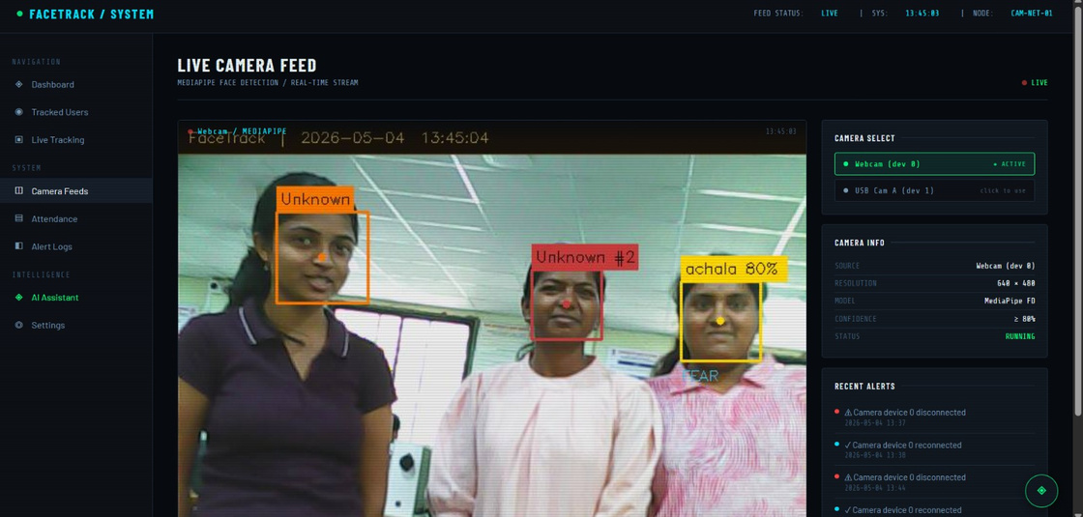
RESULTS
Live Camera Feed Dashboard
Camera Feed page: Achala recognised at 80% (yellow), two unknowns (orange, red), emotion FEAR displayed. Camera Info panel confirms 640×480, MediaPipe FD, ≥80% threshold, status RUNNING. Alert log shows auto camera reconnection events.

Slide 20



APPLICATIONS
Smart Attendance System
Security Surveillance
Automatically logs check-in/check-out with emotion data via face recognition, eliminating manual registers.
Detects and tracks unknown individuals in real time, triggering alerts and saving snapshots for review.
Assistive Technology
Interactive Kiosks
Enables hands-free, voice-controlled interaction at reception desks or public information terminals.
Helps differently-abled users interact through gaze tracking and voice commands without physical touch.
Robotics Research Platform
Low-cost, modular testbed for pan-tilt tracking, servo control, and vision-based navigation experiments.

Slide 21
CONCLUSION
Successfully demonstrated real-time face detection, recognition, and servo tracking on a standard laptop + Arduino Uno.
Replacing Raspberry Pi with direct USB serial achieved lower latency, improved stability, reduced complexity, and lower cost.
Proportional controller with EMA smoothing and deadzone filtering ensures stable tracking even under noisy detection.
Flask dashboard delivers live video streaming, attendance management, enrollment, and AI-powered monitoring.
Modular architecture is readily extensible for smart surveillance, automated attendance, and assistive robotics.

Slide 22
FUTURE SCOPE
Replace SG90 with stepper motor for smoother full 360° rotation; add multi-camera coverage.
Integrate YOLOv8 for improved multi-object tracking; deploy on NVIDIA Jetson Nano / Raspberry Pi 5.
Add gesture-based control (MediaPipe Hands) and voice commands via OpenAI Whisper.
Cloud integration via Firebase / AWS; vibration stabilisation using IMU sensors.
Reinforcement learning-based adaptive controller to auto-optimise tracking without manual calibration.

Slide 23
REFERENCES
Viola P. & Jones M. (2001). Rapid Object Detection using a Boosted Cascade of Simple Features. IEEE CVPR.
Redmon J. et al. (2016). You Only Look Once: Unified, Real-Time Object Detection. IEEE CVPR.
Lugaresi C. et al. (2019). MediaPipe: A Framework for Building Perception Pipelines. IEEE CVPR Workshops.
Deng J. et al. (2019). ArcFace: Additive Angular Margin Loss for Deep Face Recognition. IEEE CVPR.
Taigman Y. et al. (2014). DeepFace: Closing the Gap to Human-Level Performance in Face Verification. IEEE CVPR.
OpenCV Documentation — https://opencv.org
Shinde A. & Kulkarni P. (2024). Smart Mirror Interface Using Interactive Vision Systems. IEEE HCI Conference.
MediaPipe Documentation — https://mediapipe.dev
Arduino Servo Motor Control Basics — https://www.arduino.cc

Slide 24

THANK YOU

